Slide 1

WEATHER RAINFALL
PREDICTION
PRESENTED BY
IRFANA SHERIN
DATA SCIENCE
This Photo by Unknown Author is licensed under CC BY

Slide 2
INTRODUCTION
This project focuses on predicting whether it will rain tomorrow using the WeatherAUS dataset provided by the Australian Bureau of Meteorology.
The dataset contains 10+ years of daily weather observations collected across different locations in Australia.
It includes features such as temperature, humidity, wind speed, pressure, cloud cover, and rainfall measurements.
The main objective of the project is to analyze weather patterns, perform data preprocessing, and build machine learning models to accurately classify RainTomorrow (Yes/No).

Slide 3
OBJECTIVE
Analyze historical Australian weather data for rainfall patterns.
Preprocess the dataset by handling missing and categorical values.
Build machine learning models to predict RainTomorrow.
Evaluate model accuracy and select the best-performing model

Slide 4

WHAT IS WEATHER RAINFALL?
WeatherAUS Rainfall refers to the Australian weather dataset that contains daily weather observations collected across different locations in Australia. It is mainly used for predicting rainfall, especially whether it will rain tomorrow (RainTomorrow).
This Photo by Unknown Author is licensed under CC BY-NC-ND

Slide 5
KEY CONTENTS
Overview of the WeatherAUS dataset.
Important weather features used for prediction.
RainToday and RainTomorrow indicators.
Temperature, humidity, wind, and pressure details.
Historical rainfall measurements across Australia.
Purpose:-
Predicting tomorrow’s rainfall using ML models

Slide 6
DATA COLLECTION
Purpose:-
The purpose of the topic ‘WeatherAUS Rainfall Prediction’ is to analyze historical weather data and predict whether it will rain tomorrow using data-driven machine learning techniques.
Front End (Gradio):-
A user-friendly Gradio interface allows users to input features such as Temperature, Humidity, Wind Speed, Wind Direction, Pressure, and RainToday values to easily predict RainTomorrow (Yes/No).
ML Models Used:-
Logistic Regression, Random Forest Classifier, and XGBoost were employed to build accurate and reliable rainfall prediction models.

Slide 7
PROCESS OF DATASET
Data Collection:-
WeatherAUS dataset collected from the Australian of Meteorology.
Data Cleaning:-
Handle missing values and fix inconsistent weather records.
Preprocessing:-
Encode categorical features and scale numerical values.
Feature Selection:-
Select key factors like humidity, rainfall, pressure, and wind features.
Modeling:-
Train models like Logistic Regression, Random Forest, and XGBoost and evaluate accuracy.

Slide 8
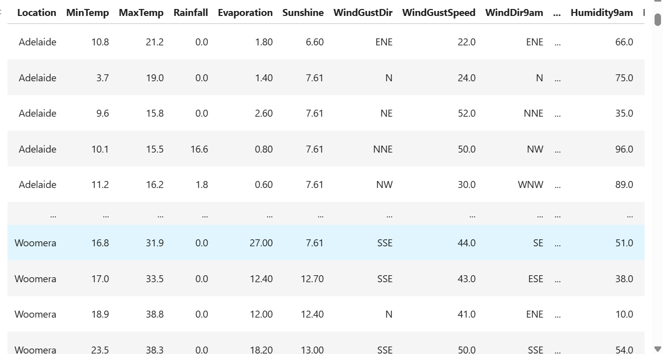
DATASET

Slide 9
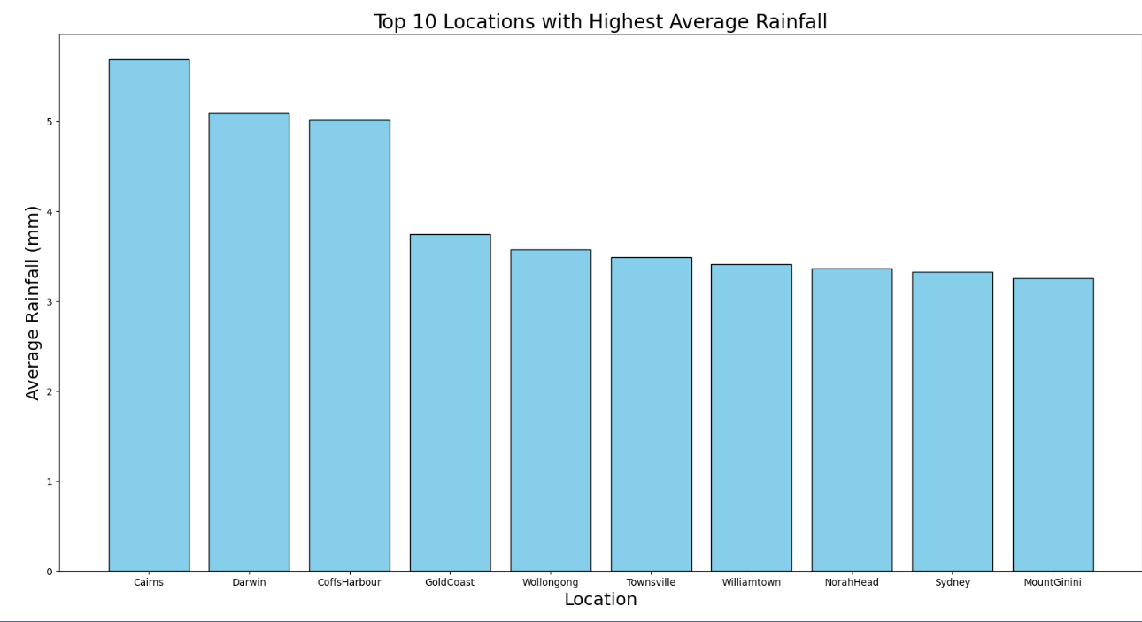
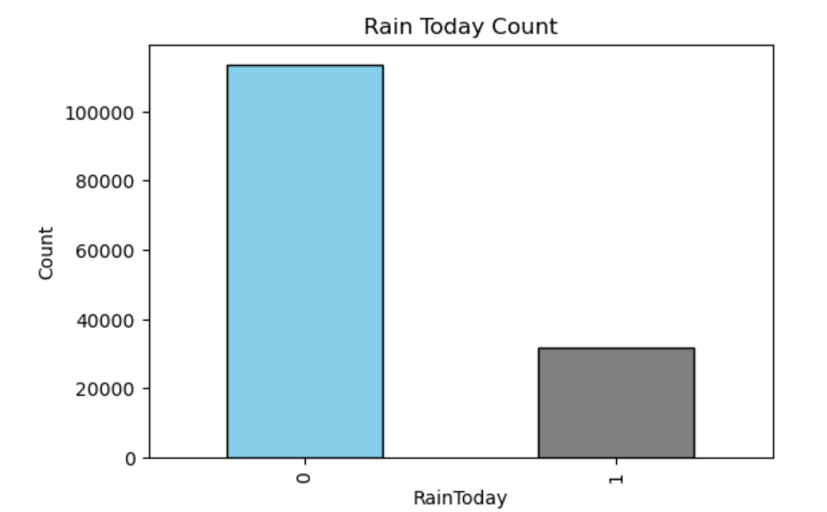
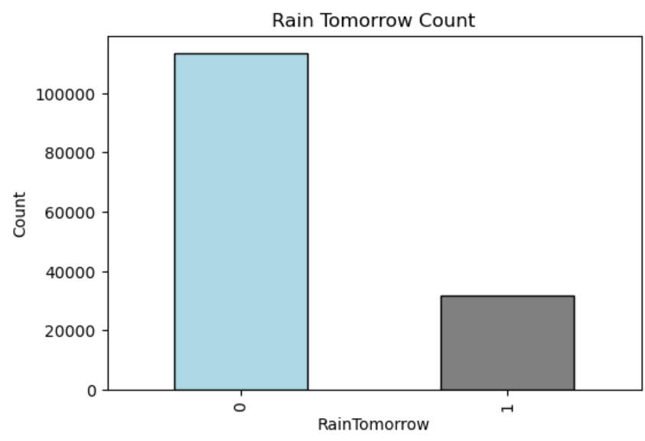
GRAPHICAL OVERVIEW

Slide 10
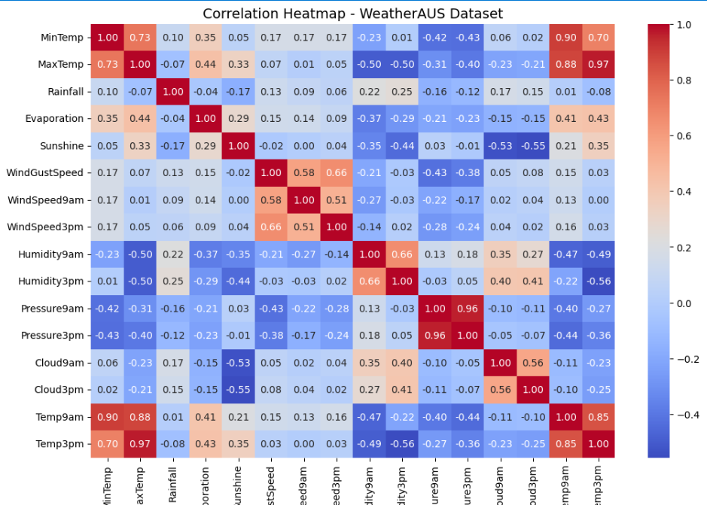
Correlation Heatmap

Slide 11
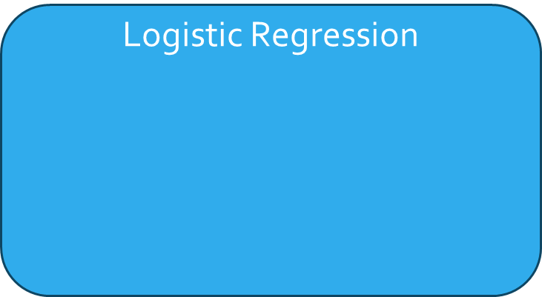
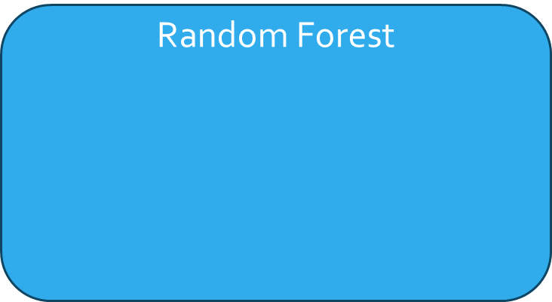
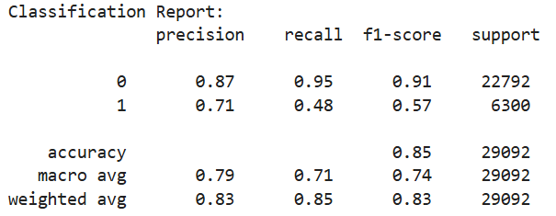
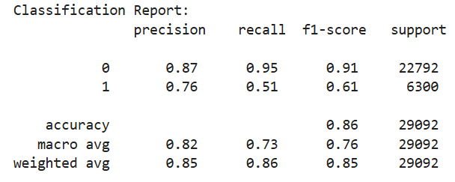
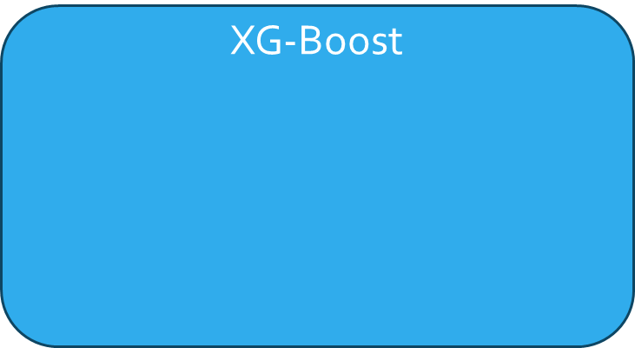
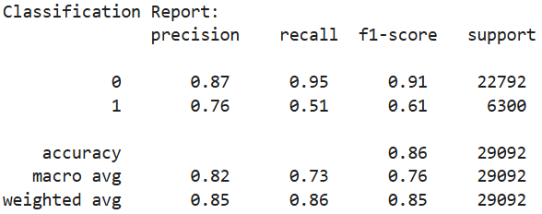
RESULT OBTAINED

Slide 12
COMPARISON TABLE
 | Model | TrainingScore | TestingScore
0 | LogisticRegression | 0.843393 | 0.845078
1 | RandomForestClassifier | 0.999940 | 0.857624
2 | XGBoostClassifier | 0.850414 | 0.850268

Slide 13
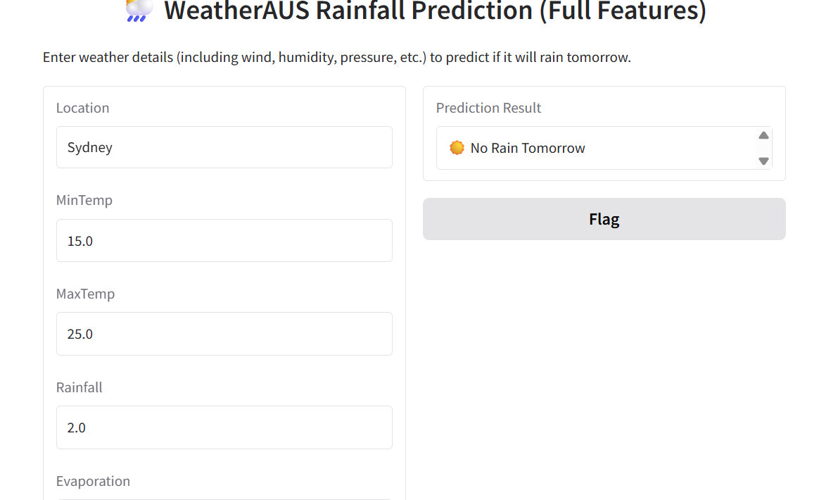
USER INTERFACE

Slide 14
FUTURE IMPROVEMENTS
Use Deep Learning models like LSTM or GRU to capture time-series weather patterns.
Add more real-time weather data from APIs to improve prediction accuracy.
Implement feature engineering to create new climate indicators for better model performance.
Deploy the model as a web or mobile app for public and agricultural use.

Slide 15
CONCLUSION
The WeatherAUS rainfall prediction project shows that historical weather data can effectively predict RainTomorrow using ML models like Logistic Regression, Random Forest, and XGBoost. With proper data cleaning and feature selection, the model provides reliable forecasts that support agriculture and weather-based decision-making.

Slide 16
THANK YOU

